Slide 1
Planning
Search vs. planning
STRIPS operators
Partial-order planning

Slide 2
What we have so far
Can TELL KB about new percepts about the world
KB maintains model of the current world state
Can ASK KB about any fact that can be inferred from KB
How can we use these components to build a planning agent,
i.e., an agent that constructs plans that can achieve its goals, and that then executes these plans?

Slide 3


Example: Robot Manipulators
Example: (courtesy of Martin Rohrmeier)

Slide 4
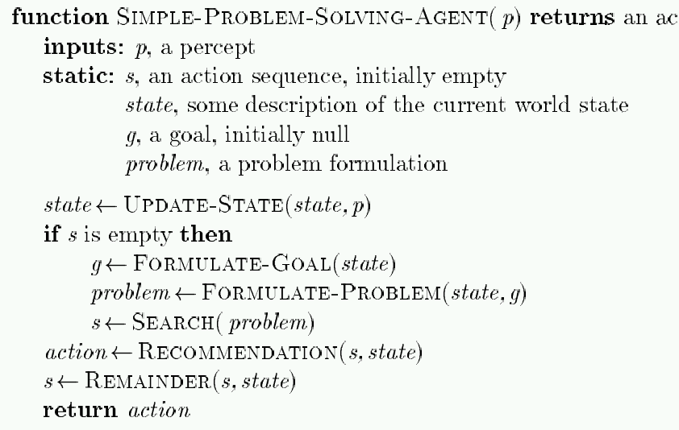
Remember: Problem-Solving Agent
tion
Note: This is offline problem-solving. Online problem-solving involves acting w/o complete knowledge of the problem and environment

Slide 5
Simple planning agent
Use percepts to build model of current world state
IDEAL-PLANNER: Given a goal, algorithm generates plan of action
STATE-DESCRIPTION: given percept, return initial state description in format required by planner
MAKE-GOAL-QUERY: used to ask KB what next goal should be

Slide 6
A Simple Planning Agent
function SIMPLE-PLANNING-AGENT(percept) returns an action
static: KB, a knowledge base (includes action descriptions)
p, a plan (initially, NoPlan)
t, a time counter (initially 0)
local variables:G, a goal
current, a current state description
TELL(KB, MAKE-PERCEPT-SENTENCE(percept, t))
current ← STATE-DESCRIPTION(KB, t)
if p = NoPlan then
G ← ASK(KB, MAKE-GOAL-QUERY(t))
p ← IDEAL-PLANNER(current, G, KB)
if p = NoPlan or p is empty then
action ← NoOp
else
action ← FIRST(p)
p ← REST(p)
TELL(KB, MAKE-ACTION-SENTENCE(action, t))
t ← t+1
return action
Like popping from a stack

Slide 7
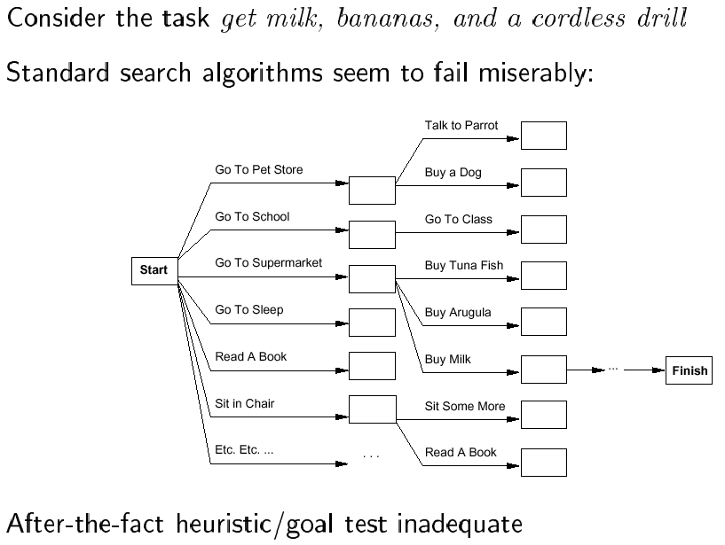
Search vs. planning

Slide 8
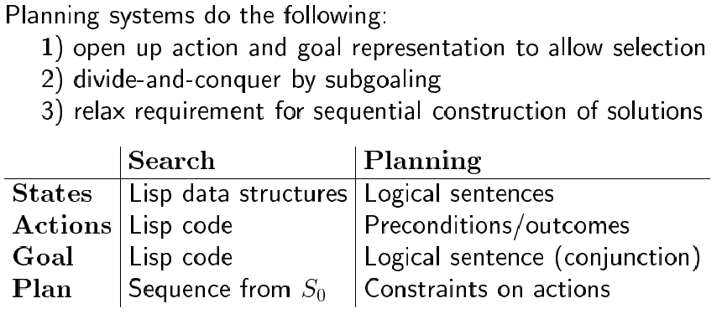
Search vs. planning

Slide 9
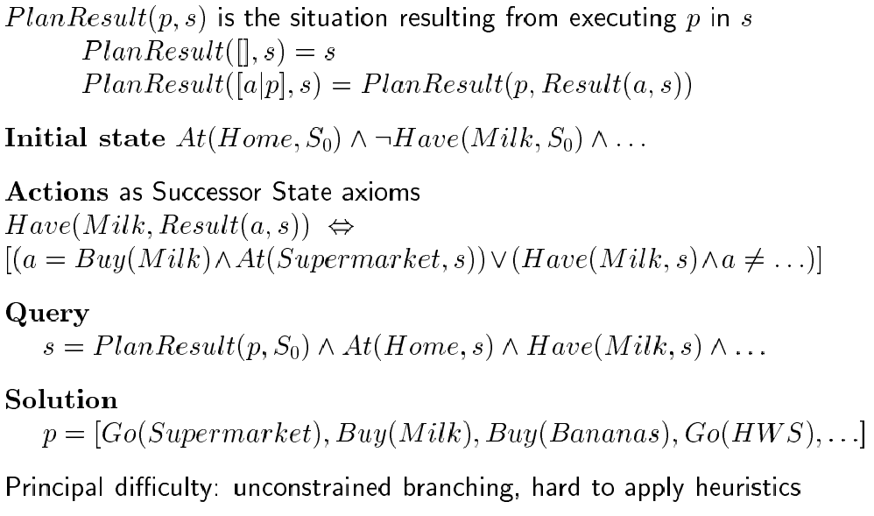
Planning in situation calculus

Slide 10
Basic representation for planning
Most widely used approach: uses STRIPS language
states: conjunctions of function-free ground literals (I.e., predicates applied to constant symbols, possibly negated); e.g.,
At(Home) ∧ ¬Have(Milk) ∧ ¬Have(Bananas) ∧ ¬Have(Drill) …
goals: also conjunctions of literals; e.g.,
At(Home) ∧ Have(Milk) ∧ Have(Bananas) ∧ Have(Drill)
but can also contain variables (implicitly universally quant.); e.g.,
At(x) ∧ Sells(x, Milk)

Slide 11
Planner vs. theorem prover
Planner: ask for sequence of actions that makes goal true if executed
Theorem prover: ask whether query sentence is true given KB

Slide 12
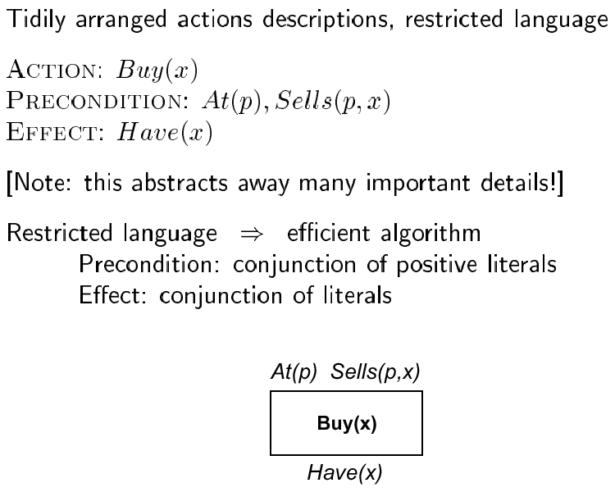
STRIPS operators
Graphical notation:

Slide 13
Types of planners
Situation space planner: search through possible situations
Progression planner: start with initial state, apply operators until goal is reached
Problem: high branching factor!
Regression planner: start from goal state and apply operators until start state reached
Why desirable? usually many more operators are applicable to
initial state than to goal state.
Difficulty: when want to achieve a conjunction of goals
Initial STRIPS algorithm: situation-space regression planner

Slide 14
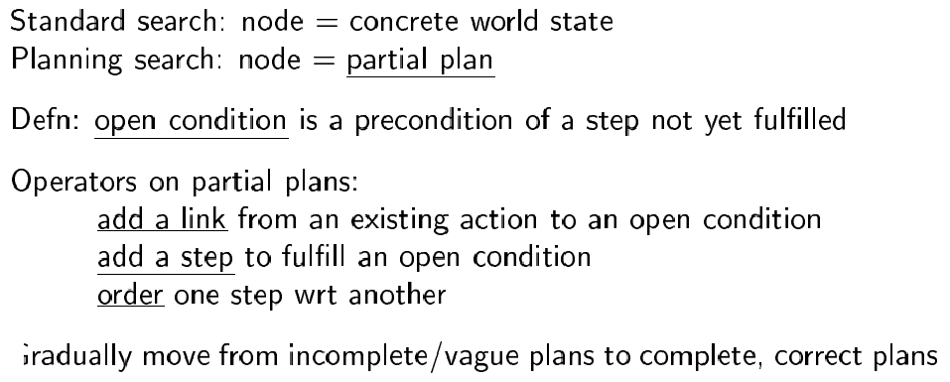
State space vs. plan space
Search space of plans rather
than of states.

Slide 15
Operations on plans
Refinement operators: add constraints to partial plan
Modification operator: every other operators

Slide 16
Types of planners
Partial order planner: some steps are ordered, some are not
Total order planner: all steps ordered (thus, plan is a simple list of steps)
Linearization: process of deriving a totally ordered plan from a partially ordered plan.

Slide 17
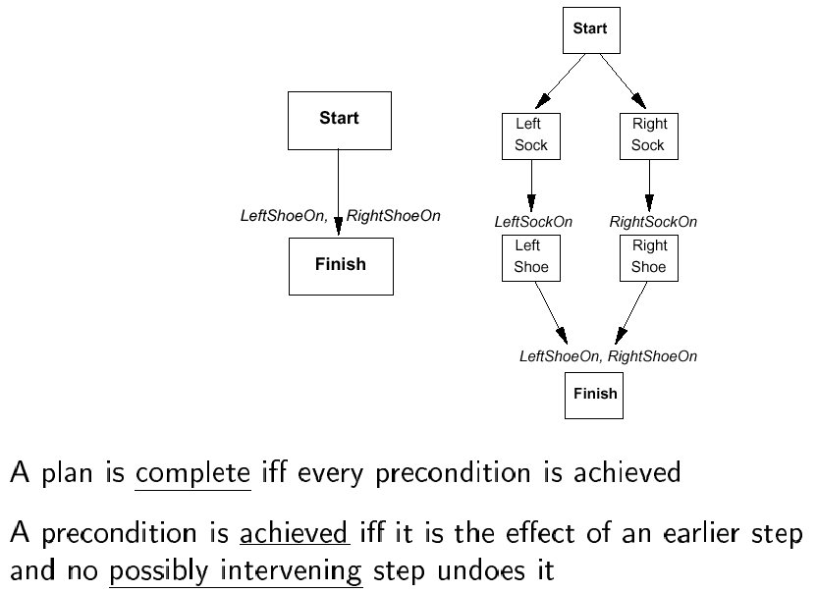
Partially ordered plans

Slide 18
Plan
We formally define a plan as a data structure consisting of:
Set of plan steps (each is an operator for the problem)
Set of step ordering constraints
e.g., A B means “A before B”
Set of variable binding constraints
e.g., v = x where v variable and x constant or other variable
Set of causal links
e.g., A B means “A achieves c for B”
c

Slide 19
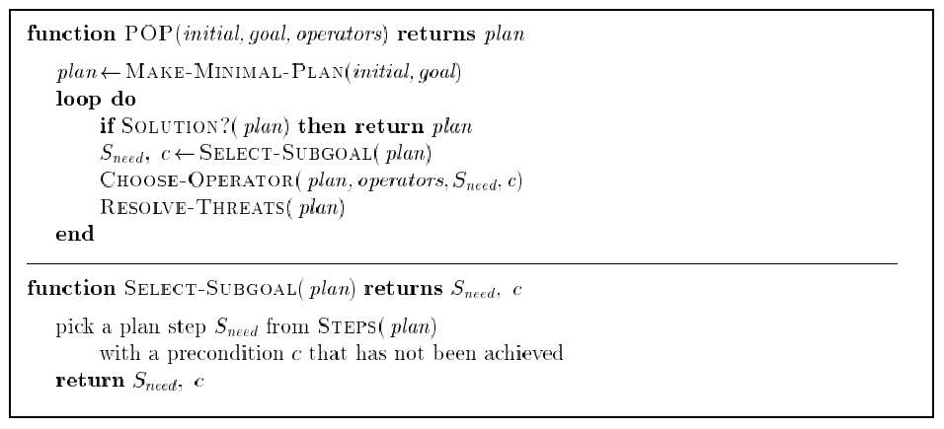
POP algorithm sketch

Slide 20
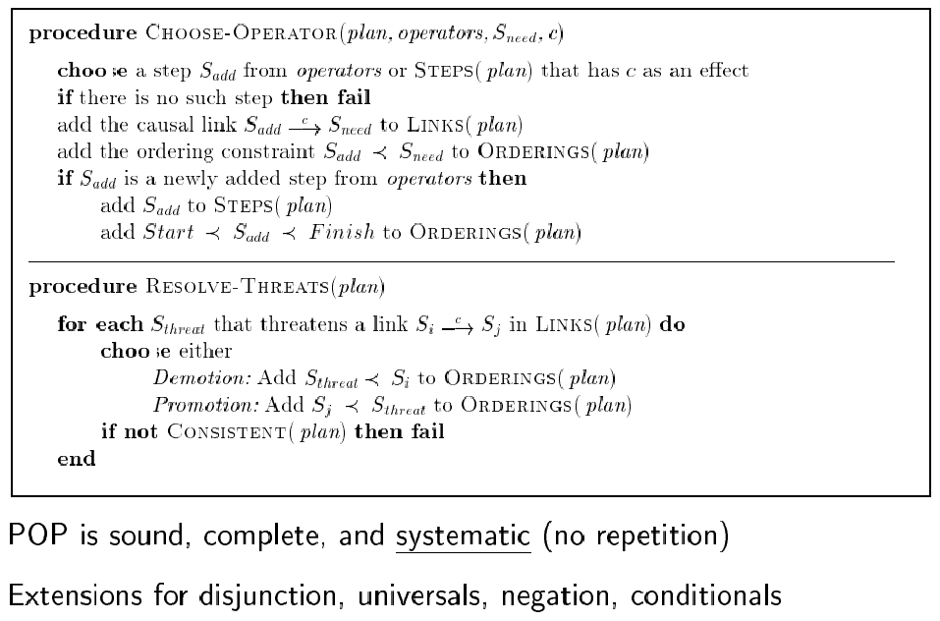
POP algorithm (cont.)

Slide 21
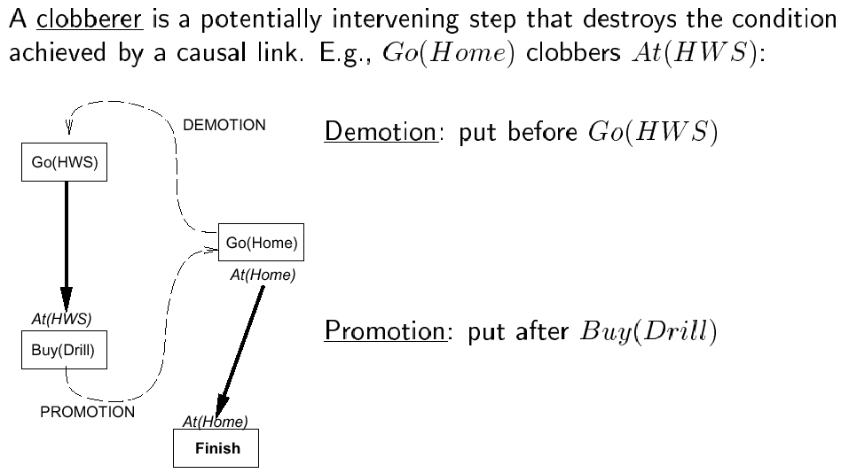
Clobbering and promotion/demotion

Slide 22
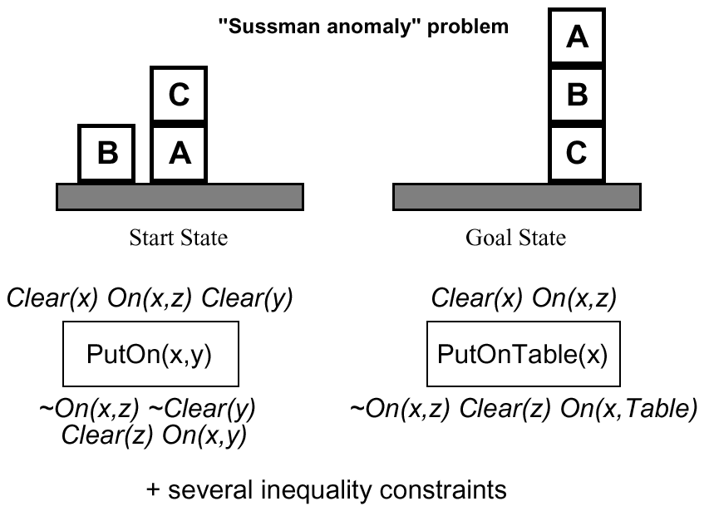
Example: block world

Slide 23
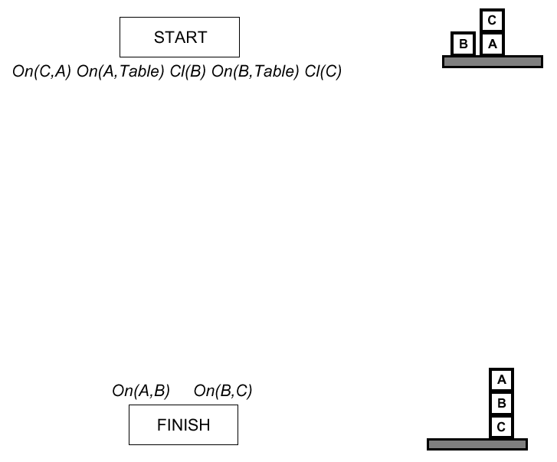
Example (cont.)

Slide 24
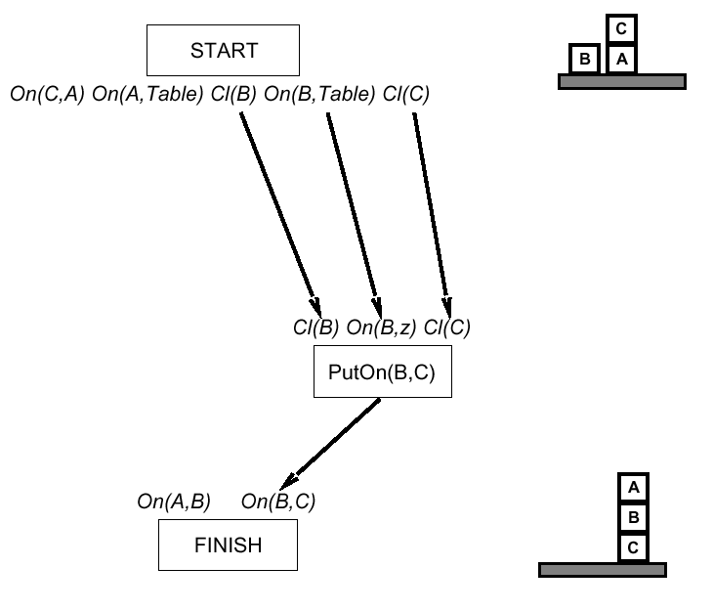
Example (cont.)

Slide 25
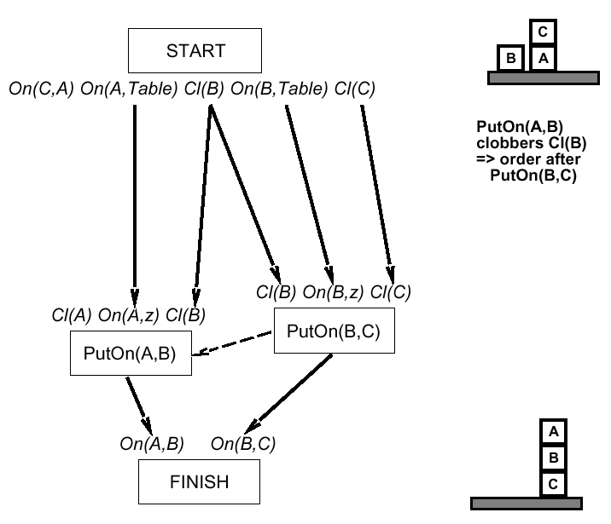
Example (cont.)

Slide 26
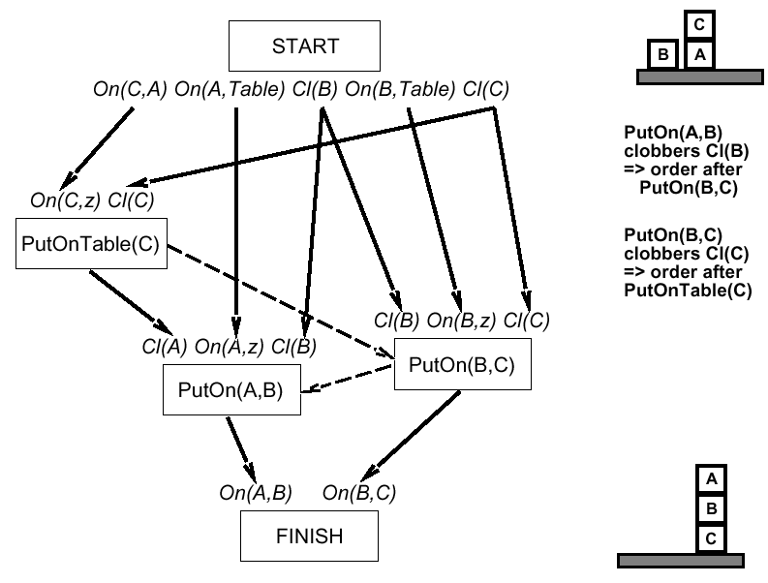
Example (cont.)

Slide 27
Planning applet

